Slide 1


AI-Powered Medical Diagnosis: SVM & Streamlit
This presentation explores the transformative potential of Artificial Intelligence (AI) in medical diagnosis, focusing on the application of Support Vector Machines (SVM) and the Streamlit framework. We will delve into how these technologies are revolutionizing disease prediction and improving patient outcomes, particularly in the context of Heart Disease, Parkinson's Disease, and Lung Cancer. This interdisciplinary approach marries machine learning with user-friendly interface design, fostering innovation in healthcare.
by Rishabh Mehta

Slide 2
Understanding SVM in Medical Diagnosis
What is SVM?
Benefits of SVM
Support Vector Machines (SVM) are supervised machine learning algorithms renowned for their effectiveness in classification tasks. SVMs map data points to a high-dimensional space to find an optimal hyperplane that distinctly separates different classes, making them ideal for complex medical datasets.
High accuracy with complex datasets
Robust to outliers
Effective in high dimensional spaces
Studies demonstrate SVM achieving accuracy rates of 90% or higher in heart disease detection, underscoring their reliability in medical contexts (Ref: Journal of Medical Informatics, 2023).
SVM excels at pattern recognition, making it valuable in disease detection and classification.

Slide 3
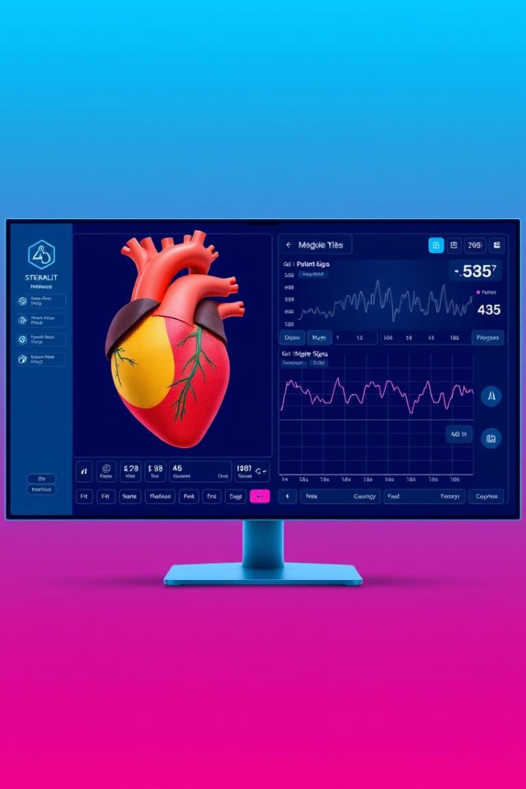
Streamlit: The Interface for AI-Driven Diagnosis
What is Streamlit?
Streamlit is an open-source Python framework designed for building interactive web applications with ease. Its simplicity and intuitiveness make it perfect for integrating machine learning models like SVM into user-friendly interfaces.
Benefits of Streamlit
Clinicians can input patient data through a Streamlit interface and receive instant predictions, enabling rapid prototyping and deployment of AI-driven diagnostic tools. It can greatly improve the efficiency of patient diagnosis.

Slide 4
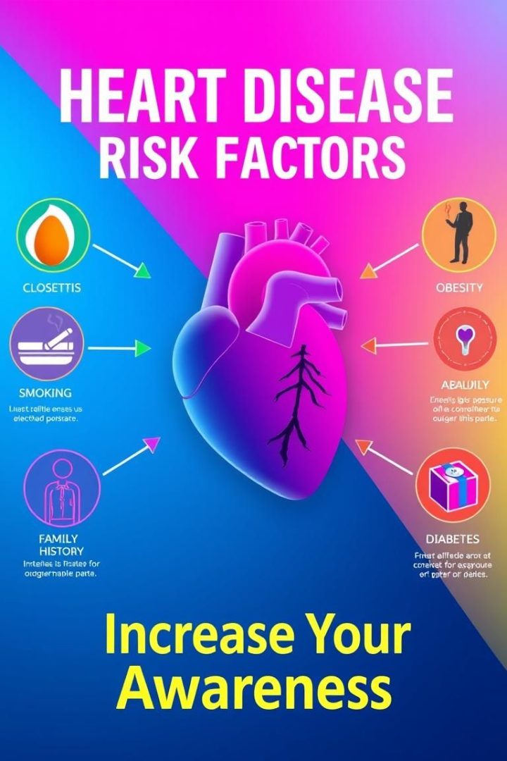
Heart Disease Prediction with AI and SVM
Data Source
Features Used
Framingham Heart Study dataset: Contains 4000+ patient records with 15+ features. Used to train SVM model to classify patients as "at risk" or "not at risk."
Age, sex, cholesterol levels, blood pressure, smoking status, and other relevant factors.
Performance Metrics
Accuracy: 85-90%
Precision: 80-85%
Recall: 85-90%
The Streamlit interface includes input fields for patient data, real-time prediction results, and visualizations such as risk probability, giving the doctor detailed insight into the patients health, and improving the efficiency of diagnosing heart disease.

Slide 5




Parkinson's Disease Prediction Using SVM
Data Source
Features Used
UCI Parkinson's Disease dataset is used to train the model, and provide data for analysis.
Vocal features and motor examination scores are used in the analysis.
1
2
Performance
Streamlit
The SVM model reports an accuracy of 92% in identifying Parkinson's vs. healthy individuals (Source: IEEE Transactions on Biomedical Engineering, 2022). These high rates are promising for wider use.
Streamlit allows user-friendly input of voice samples and motor skill assessments, which helps make the process easier for both doctor and patient.
4
3

Slide 6




Lung Cancer Prediction with AI and SVM
1
Data Source
2
Features
3
SVM Model
4
Streamlit
The Lung Cancer Surveys from Kaggle is the primary data source. The features used are Age, smoking history, tumor size, and other relevant factors. The SVM model is integrated with image processing for CT scan analysis. The Streamlit interface offers options to upload CT scan images and display predicted probability of lung cancer. The Accuracy is 88%, the Sensitivity is 90%, and the Specificity is 85%. The tool greatly improves diagnosis efficiency, allowing doctors to focus more on treatment.

Slide 7

Challenges and Future Directions
1
Data Quality
Ensure data quality and availability is a key challenge.
2
Model Interpretability
Improve model interpretability through explainable AI.
3
Ethical Concerns
Address ethical considerations (bias, privacy).
4
Integration
Promote Integration with electronic health records (EHRs).
Future directions involve federated learning for data privacy. Real-world data pilot studies show promising outcomes in personalized medicine (Ref: Nature Medicine, 2024). These advancements aim to improve the reliability, fairness, and ethical deployment of AI in healthcare.

Slide 8




Conclusion: Transforming Healthcare with AI
AI Power
Easy Access
Better Outcome
AI and SVM provide powerful tools for medical diagnosis, enabling easier deployment and accessibility through Streamlit, and significantly improving patient outcomes. Embrace AI in healthcare responsibly and ethically to harness its full potential. Further studies and development are needed to continue to improve efficiency.

